Slide 1
SMART WASHING MACHINE
K.SUMA
160041036

Slide 2
ABSTRACT:
Smart washing machine is a machine which is used to wash clothes smartly. In this project smart washing machine contains 6 options Fully Automatic, Semi-Automatic, Washing, Soaking, Rinsing, Draining. While washing clothes if the water in the tank is low than 20% then the motor gets ON automatically and the tank fills to a particular safe level.

Slide 3

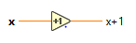
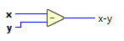
LIST OF SYMBOLS AND ABBREVIATIONS:
Wait ms: Waits the specified number of milliseconds and returns the value of milliseconds timer
Decrement: subtracts one from the value
increment: adds one to the value
Subtract : computes the difference of the inputs

Slide 4
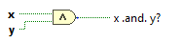
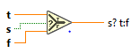
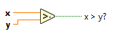
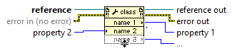
AND : Computes the logical AND of the inputs .Both inputs must be Boolean values ,numerical values or error clusters. if both inputs are TRUE the function returns TRUE otherwise it returns FALSE
Greater?: returns TRUE if x is greater than y otherwise this function returns false
Select : Returns the value wired to the t input or f input depending on the value of s ,if s is TRUE this function returns the value t if S is False the function returns the value of f
Property node : Use the property note to get a set properties and methods on local or remote application instances, VI’S and objects

Slide 5
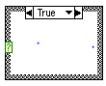
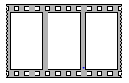
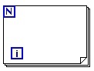
Case structure : Contains one or more sub diagrams or cases exactly one of which execute when the structure execute s. The value wired to the case selector determines the case to execute
For loop: Executes its sub diagram n times Where n is the value of to the count (N) terminal ,the iteration I terminal provides the current loop iteration count which ranges from 0 to n-1
Flat sequence: Consist of one or more sub diagrams or frames that execute sequentially use the flag sequence structure to ensure that a sub diagram execute before or after another sub diagram. data flow for the flat sequence structure differs from data flow for any other structures. frame in flat sequence structure execute from left to right and when all data values wired to a frame are available

Slide 6
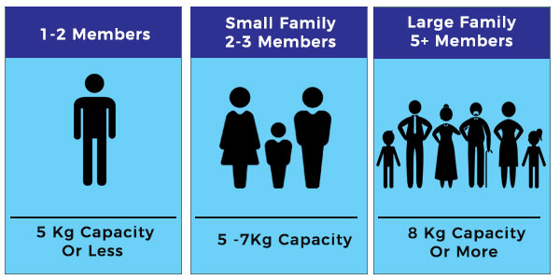
How To Choose A Washing Machine?

Slide 7
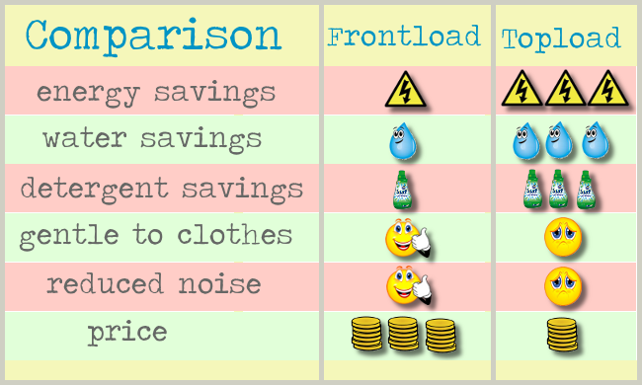
Front Load Or Top Load?

Slide 8
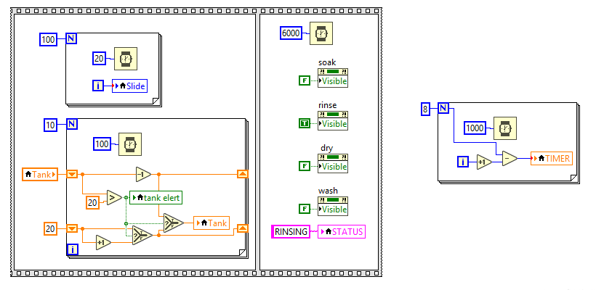
block diagram of rinsing part

Slide 9
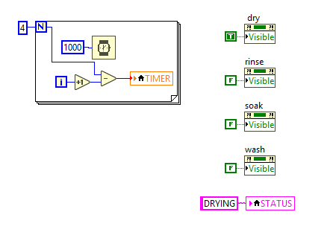
block diagram of drying part

Slide 10
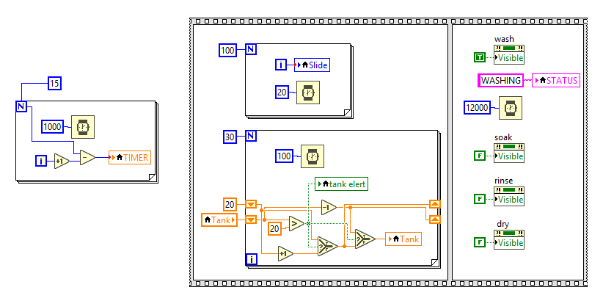
block diagram of washing part

Slide 11
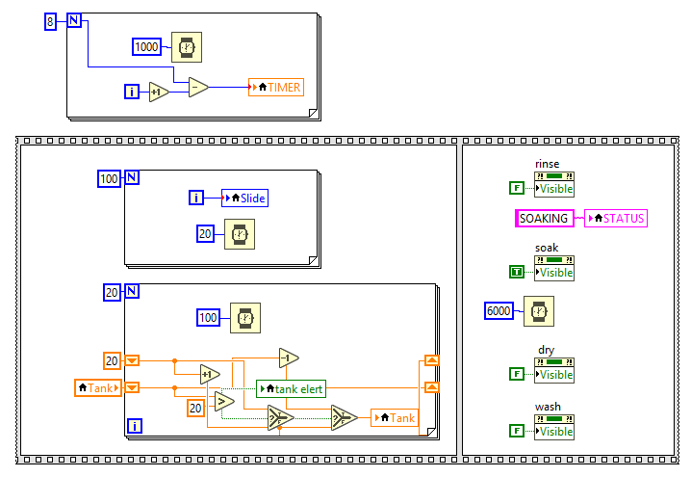
block diagram of soaking part

Slide 12
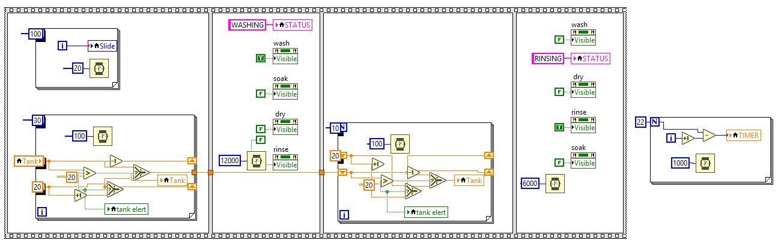
block diagram of semi automatic part

Slide 13
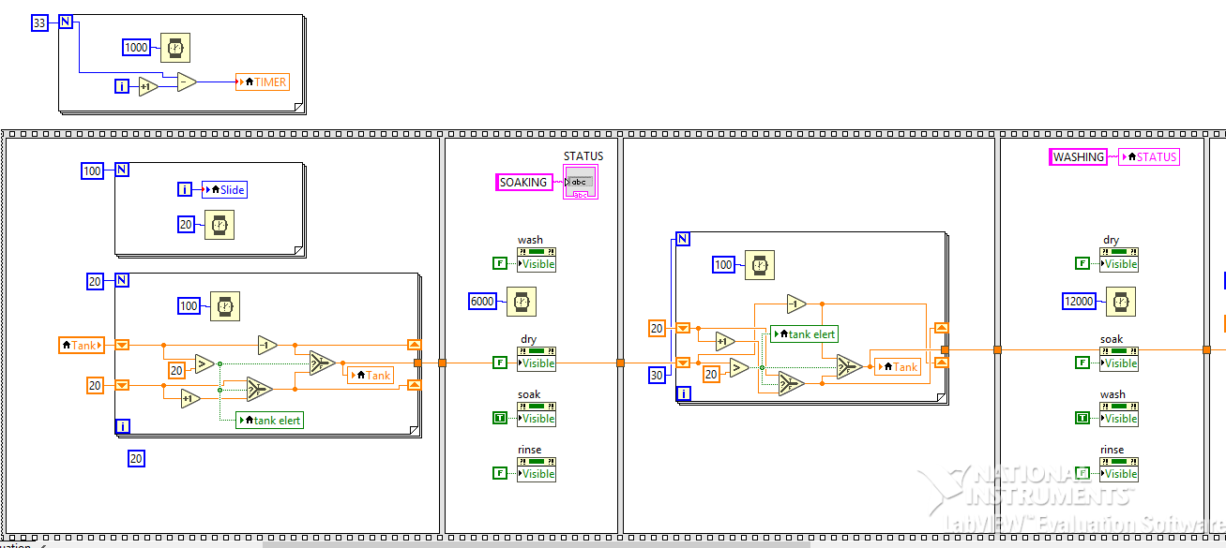
block diagram of fully automatic part-1

Slide 14
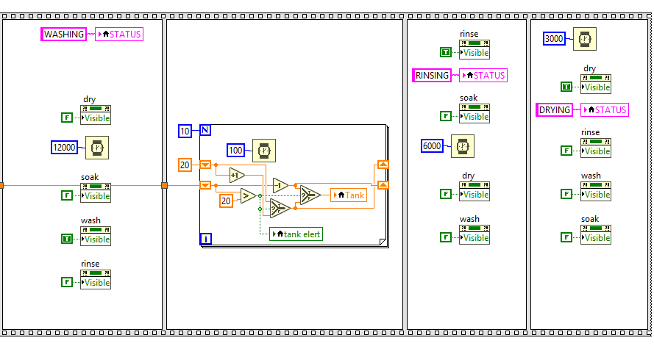
block diagram of fully automatic part-2

Slide 15
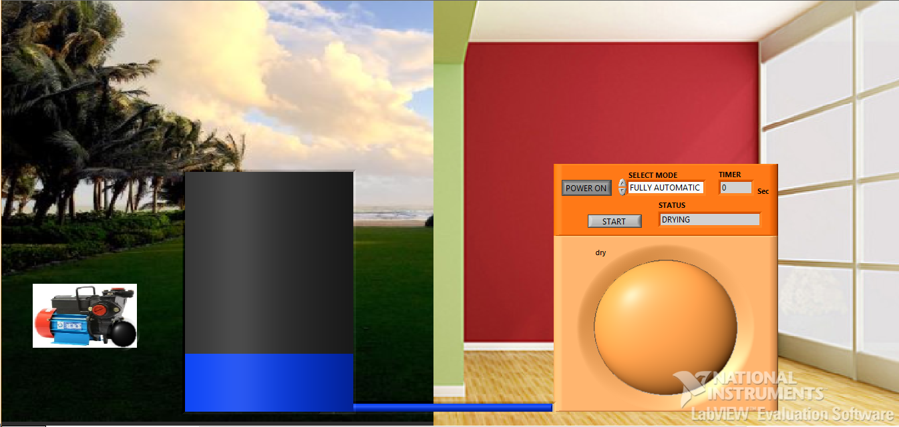
FRONT PANEL OF LABVIEW:

Slide 16
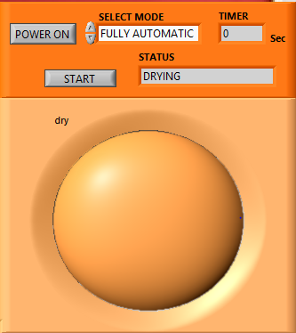
options in smart washing machine

Slide 17
RESULTS

Slide 18
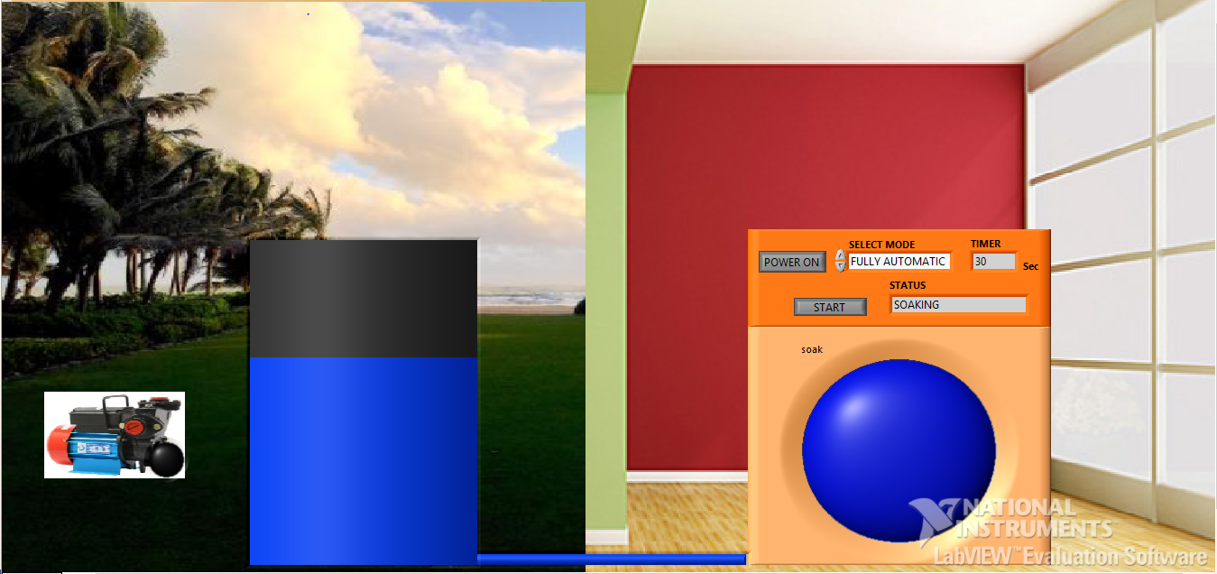
FULLY AUTOMATIC

Slide 19
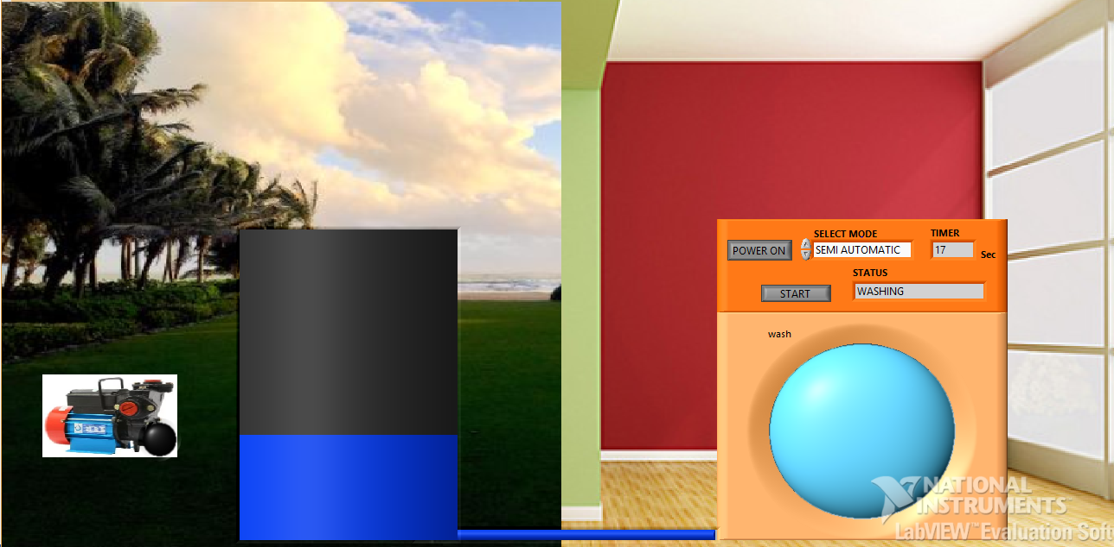
SEMI AUTOMATIC

Slide 20
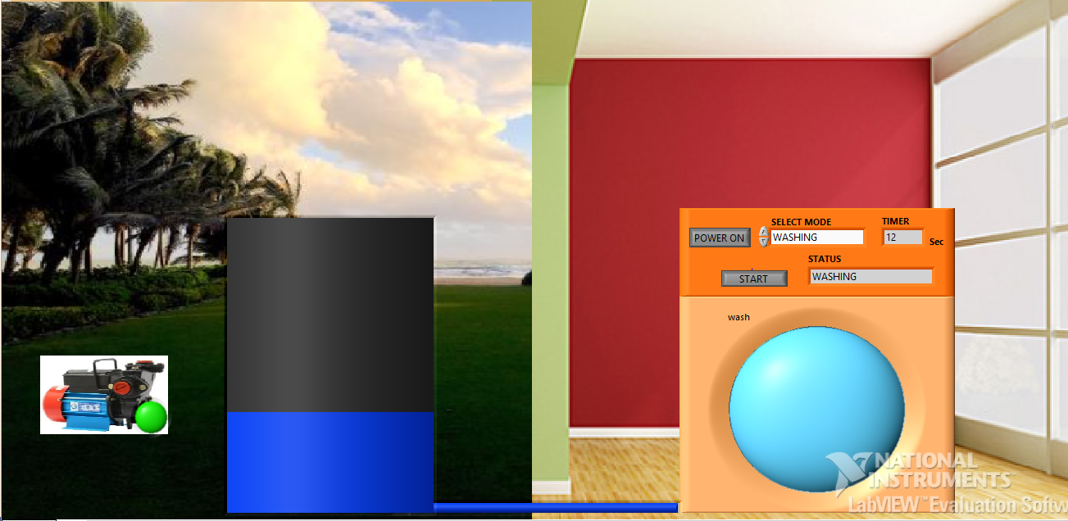
WASHING

Slide 21
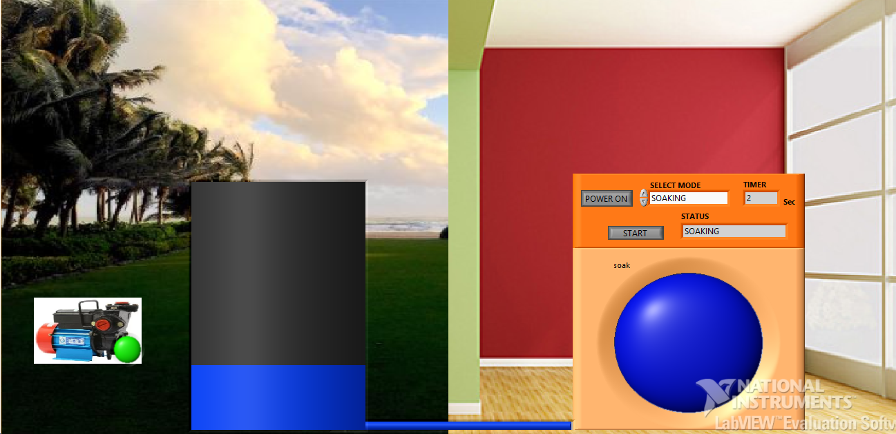
SOAKING

Slide 22
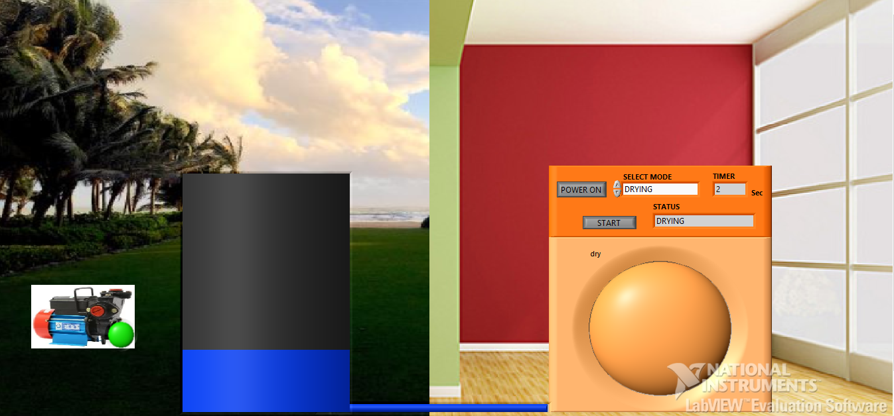
DRYING

Slide 23
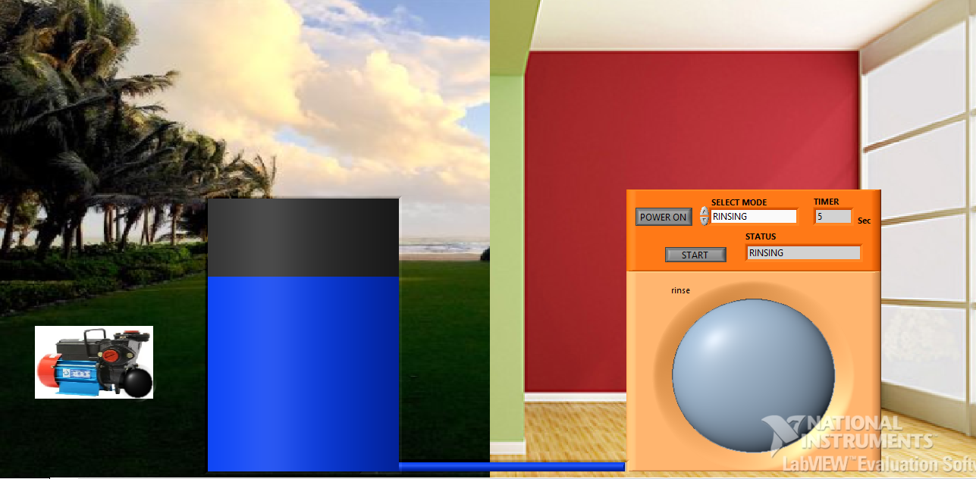
RINSING

Slide 24
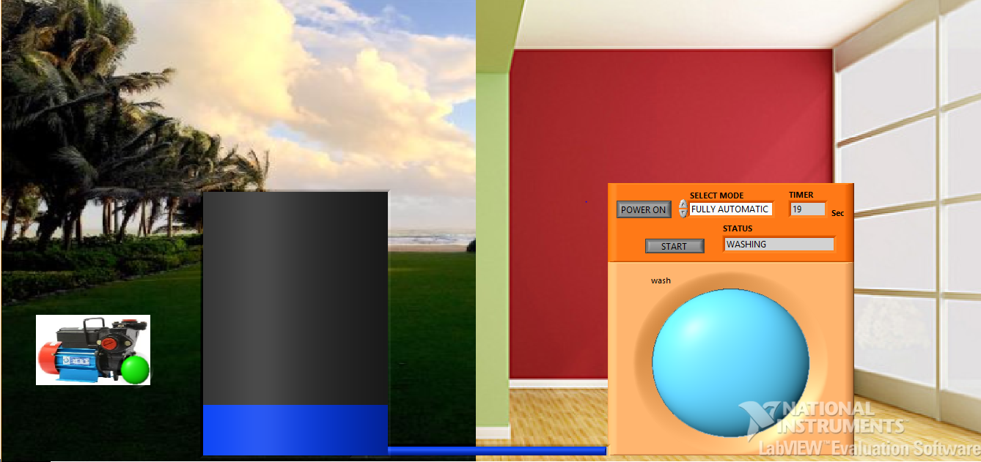
MOTOR ON

Slide 25
CONCLUSIONS
Smart washing machines are user friendly and easy to be operated. If we use front loaded washing machine then the water consumption is also less and electricity consumption is also less. If you take top loaded washing machine then it consumes high power and more water is also consumed. Compared to front loaded top loaded washing machines are expensive. In front loading washing machines the durability of the motor is good. This project can further be developed in the regions like remote controlled or other comforts like automatic power control based on the voice recognition of the user

Slide 26
FUTURE SCOPE
In future washing machines may use beads instead of water
Remote controlled washing machine may evolve
Automatic detergent dosing
Larger capacity washing machines

Slide 27
THANKYOU

